Slide 1
Starting Out With C++ From Control Structures Through Objects
Chapter 13

Slide 2
Chapter 13: Introduction to Classes
13.1 Procedural and Object Oriented Programming
13.2 Introduction to Classes
13.3 Defining an Instance of a Class
13.4 Why Have Private Members?
13.5 Focus on Software Engineering: Separating Class Specification from Implementation
13.6 Inline Member Functions

Slide 3
13.1 Procedural and Object Oriented Programming
Procedural – typically have data stored in a collection of variables and/or structures, coupled with a set of functions that perform operations on the data; data and functions are separate entities
The focus of procedural programming is on creating the functions that operate on the program’s data
Problems with separating data and functions led to Object Oriented Programming
OOP is centered on creating objects
An object is a software entity that contains both data and procedures
The data that are contained in an object are known as the object’s attributes
The procedures that an object performs are called member functions
The object is, conceptually, a self-contained unit consisting of attributes and procedures

Slide 4
OOP addresses the problems that can result from the separation of code and data through encapsulation and data hiding
Encapsulation – refers to the combining of data and code into a single object
Data hiding – refers to an object’s ability to hide its data from code that is outside the object
Only the object’s member functions may directly access and make changes to the object’s data
Object’s hide their data but allows outside code to access member functions
This allows object data to be protected from accidental corruption as outside code knows nothing about it
Example of OOP would be a car
Consists of ignition, steering, gas pedal, brake pedal, transmission
The user only interacts with the objects themselves, don’t need to know what happens mechanically when turning the steering wheel
When we use Library Functions and header files, we are implementing OOP

Slide 5
Object Reusability
OOP implements a more specific version of code reusability in object reusability
Imagine the steering wheel object of a car: This object is made once and can successfully be used on many different cars with many different users

Slide 6
Classes and Objects
A programmer determines the attributes and functions that are necessary and then creates a class
class – is code that specifies the attributes and member functions that a particular type of object may have, think of a class as a blueprint that objects may be produced from
We use the created class to create the objects
Each object that is created from a class is called an instance of the class
EX: Class CAR has attributes COLOR, SIZE, TYPE
We can create an instance that is named CAR1 that is blue, large, and a sedan
We can create another instance named CAR2 that is green, small, coupe
So on so forth

Slide 7
Using a Class You Already Know
So far, we’ve dealt with the string class
anytime we use a string, we need the #include <string> header file to reference the string class
We create instances of string objects by defining strings: string Name;
Once the object is created, we can store data in it and use all member functions of the string class:
Name = “Bobby”; Name.find(‘o’); Name.append(“ Loneker”);

Slide 8
13.2 Introduction to Classes
A class is similar to a structure, it is a data type defined by the programmer, consisting of variables and funcitons
General syntax: class ClassName { declaration; //more declarations };
Don’t forget the semicolon after the last bracket
The declaration statements inside a class declaration are for the variables and functions that are member of that class
Unlike structures, the members of a class are private by default, which means they cannot be accessed by programming statements outside the class
A class’s public members may be accessed by code outside the class

Slide 9
Access Specifiers
C++ provides the key words private and public, which you may use in class declarations.
These are known as Access Specifiers because they specify how class members may be accessed
General syntax: class ClassName { private: //declaration of private members public: //declaration of public members };
The private specifier goes first, all things after the colon leading up to the key word public are for private members

Slide 10
Public Member Functions
To allow access to a class’s private member variables, you create public member functions that work with the private member variables
Here is an example of public function declarations: class Rectangle { private: double width; double length; public: void setWidth(double); void setLength(double); double getArea() const; };
must use setWidth function to access and alter private width member function
Member Function | Description
setWidth | The function accepts an argument, which is assigned to the width member variable
setLength | The function accepts an argument, which is assigned to the length member variable
getArea | This function returns the product of the width member variable multiplied by the length member variable, this value is the area of the rectangle

Slide 11
Using const with Member Functions
Notice that the key word const appears in the declaration of the getArea member function: double getArea() const;
When this key word appears after the parentheses in a member function declaration, it specifies that the function will not change any data stored in the calling object
We will get an error if the class’s member function tries to alter data from the caller

Slide 12
Placement of public and private Members
It is not required that you declare all private members before all public members, nor a rule that says you can declare members in different places, but you should adopt a style
public: //declarations private: //declarations
private: //declarations public: //declaration private: //more declarations

Slide 13
Defining Member Functions
The definitions of the member functions are written outside the class declaration:
void Rectangle::setWidth(double w) { width = w; }
void Rectangle::setLength(double l) { length = l; }
double Rectangle::getArea() const { return width * length; }
The two colons together are called the scope resolution operator, the “Rectangle::” syntax is confirming the function is a member of the Rectangle class
General syntax for function header of member function: ReturnType ClassName::functionName(ParameterList)
Need the Scope Resolution operator in order to make the function a class member function

Slide 14
Accessors and Mutators
A member function that gets a value from a class’s member variable but does not change it is known as an accessor
A member function that stores a value in the member variable or changes the value is known as a mutator
setWidth and setLength are mutators
getArea (displaying the variable contents) are accessors
can also think of mutators as setter functions and accessors and getter functions

Slide 15
Using const with Accessors
Remember the getArea() function was declared in the class with the const key word
The const key word must appear in both the declaration and the function header
This tells the computer the function will not alter the calling object’s data

Slide 16
The Importance of Data Hiding
It is very important to hide data from other users
This will ensure the data is used for the intended functionality that the code was developed for
It will also alleviate risks with intentional and accidental alterations

Slide 17
13.3 Defining an Instance of a Class
Just like variables, class objects are not created in memory until they are defined
ClassName objectName;
Rectangle box;
Defining a class object is called the instantiation of a class, in this statement, box is an instance of the Rectangle class

Slide 18
Accessing an Object’s Members
box is now an object from the Rectangle class
In order to access member variables, we must use member functions
box.setWidth(12.7);
box.setLength(14);
int x = box.getArea();
This function has access to the width variable from the Rectangle class

Slide 19
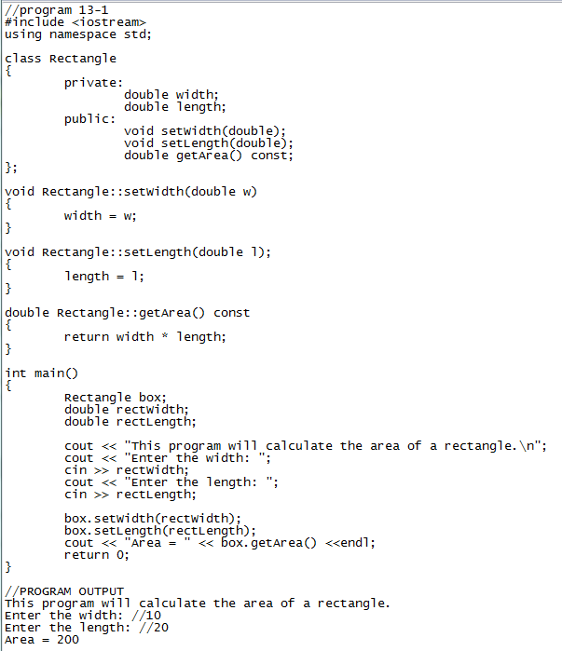
A Class Demonstration Program
Let’s follow along with program 13-1 and create our own program with a Rectangle class
Then create a few more instances of the Rectangle class, call them: LivingRoom, Kitchen, Bathroom
Each instance has it’s own copy of the Rectangle Class member variables so data in each instance isn’t overwritten when altering member variables
box.setLength(5) kitchen.setLength(5)

Slide 20
Avoiding Stale Data
When the value of an item is dependent on other data and that item is not updated when the other data are changed, it is said that the item has become stale
If we create a member variable area and store the value of length*width in it, as soon as we change either of those two member variables, the old contents in area are incorrect and stale
When creating classes, take this into account and provide member functions that return the result of calculations, not store them in member variables

Slide 21
Pointers to Objects
We can also create pointers that point to class objects
Rectangle *recPtr = nullptr; //recPtr holds the address of a Rectangle object
Rectangle myRectangle;
rectPtr = &myRectangle;
With this notation, we can call member functions from the object using the ‘->’ operator
rectPtr->setWidth(12.5);
rectPtr->setLength(4.8);
Since we are using pointer notation, we can delete the object from memory
delete rectPtr;
Let’s add another instance of our Rectangle class using pointer notation

Slide 22
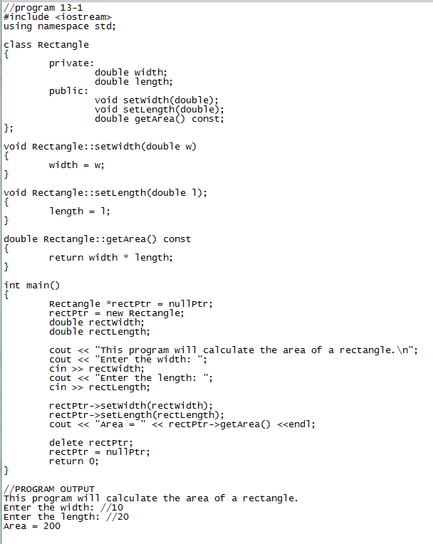
Can also make use of smart pointers that auto delete memory when done

Slide 23
13.4 Why Have Private Members?
Again, we create private members to keep certain data safe
Data that the user does not need to interact with should be private for safety from alterations
Functions that the user does not need to use but are used to generate calculations in a class should also be private
The interface between the user and private members are the public members
We can also use the public member functions to filter out bad data (input validation) before storing anything to the private members
Example: void Rectangle::setLength(double len) { if (len >= 0) length = len; else { cout << “Invalid length\n”; } }

Slide 24
13.5 Focus on Software Engineering: Separating Class Specification From Implementation
Up to now, we have provided all class declaration, member function, and application data on one file
The more efficient way of handling data is to save the application data and class declaration/member functions on their own files
Class declarations are stored in their own header files. A header file that contains a class declaration is called a class specification file. The name of the class specification file is the same name as the class itself with a .h extension
The member function definitions for a class are stored in a separate .cpp file called the class implementation file. The file usually has the samw name as the class, with the .cpp extension.
Any program that uses the class should #include the class’s header file. The class’s .cpp file should be compiled and linked with the main program. Visual Studio does this automatically

Slide 25
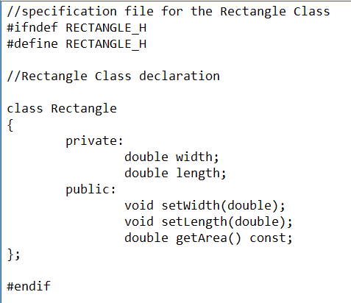
Contents of Rectangle.h
This is the specification file for the Rectangle class
Contains only declaration of the Rectangle class
There are no member function definitions, only prototypes
In order to use the Rectangle class in our program, we need to use the #include directive
We see two new preprocessor directives: #ifndef and #endif
#ifndef is called the include guard, it prevents the header file from accidentally being included more than once
It checks to see if a constant, RECTANGLE_H was defined, if not defined it then instantly creates the constant and the rest of the file is included

Slide 26
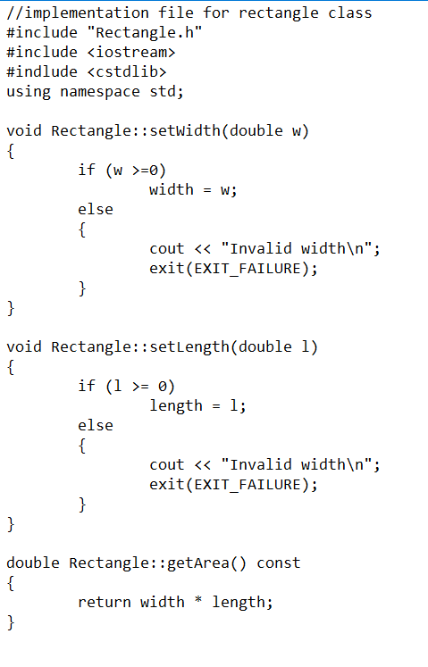
Contents of Rectangle.cpp
Next, we need an implementation file that contains the class’s member function definitions
Notice we #include the declaration file we created previously
When using system class declaration files, we enclose them in the angled carrots (< >)
When using class declaration files we, or someone else has written, not in the system, we enclose them in double quotes (“ “)
Now we create a connection between the implementation file and the declaration file

Slide 27
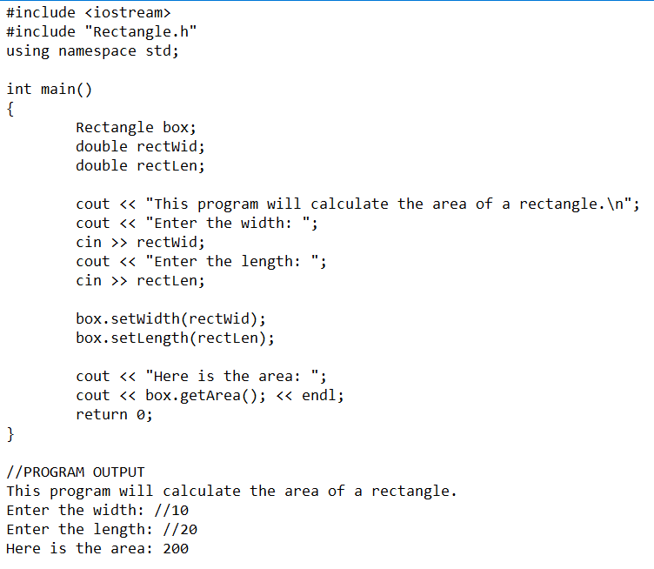
Modified Program
This program uses the class specification and implementation files we’ve created

Slide 28
Putting it all Together
Creating separate classes with implementation and declaration files is good practice of code re-use
Now, you can save that file and re-use the same code without having to retype it a bunch of times
It is also good when needing to make changes to member functions, as you only need to update one file

Slide 29
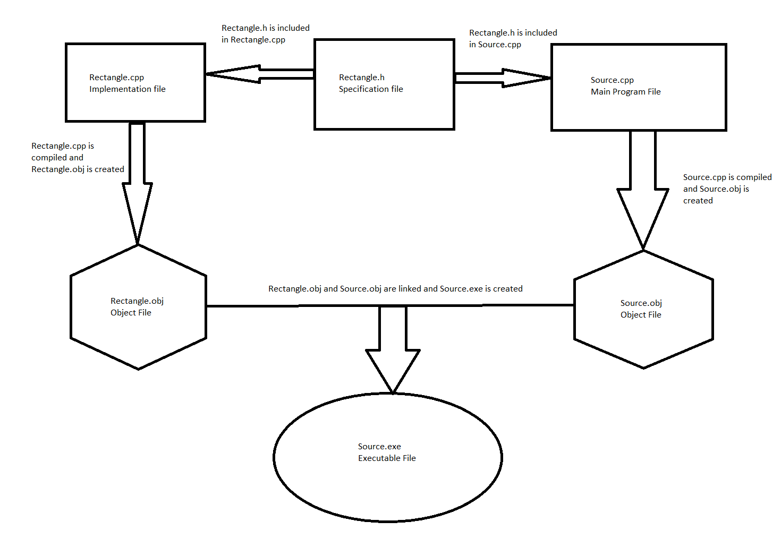

Slide 30
13.6 Inline Member Functions
When a member function is defined in the declaration of a class, it is called an inline function
Because the function definitions are part of the class, there is no need to use the scope resolution operator and class name in the function header

Slide 31
